Slide 1
Credit EDA Case Study
- By Kiran Ghadigaonkar

Slide 2
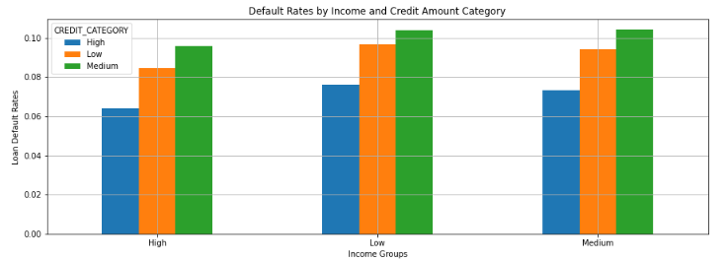
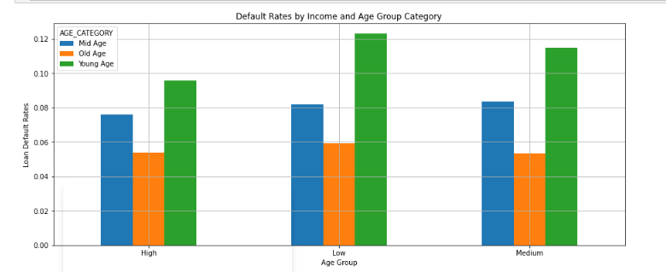
Current Application Data Analysis
High income groups has lower default rates for all 3 Credit Amount Categories as compared to Low and Medium Income groups.
Loan applicants with Young age group are more likely to default across all Income groups.

Slide 3
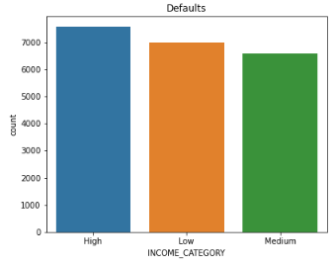
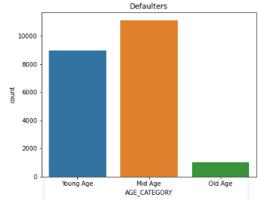
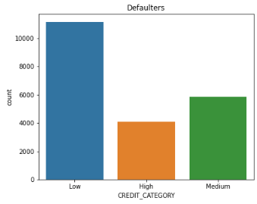
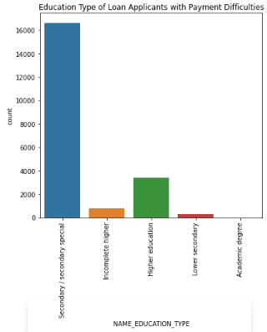
Current Application Data Analysis
Loan applicants with High Income Group are more likely to default.
Mid Age (35-55) loan applicants are more likely to default.
Loan applicants with Low Credit Amount category are more likely to default.
Secondary and Higher Secondary are more likely to default.

Slide 4
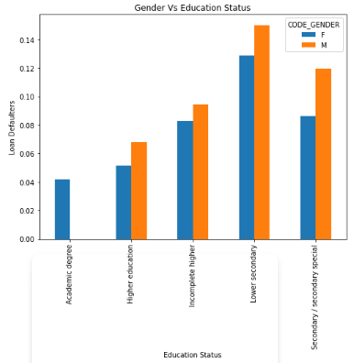
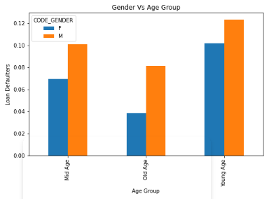
Current Application Data Analysis
Male Applicants with Lower Secondary Education are more likely to default.
Male Loan applicants across all age groups are more likely to default as compared to Female loan applicants. However, Young Male Applicants has highest chances of defaults.

Slide 5
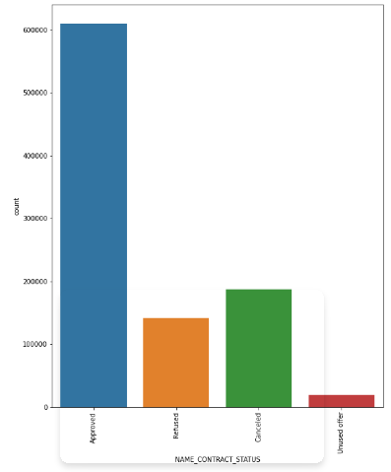
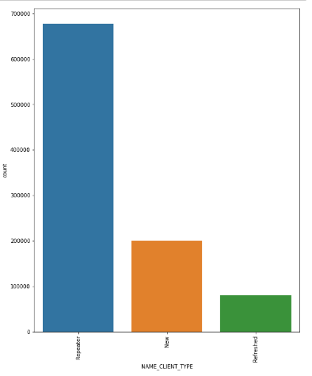
Previous Application Data Analysis
Count for Approved Loan Status is highest.
Repeater loan applicants are highest.

Slide 6
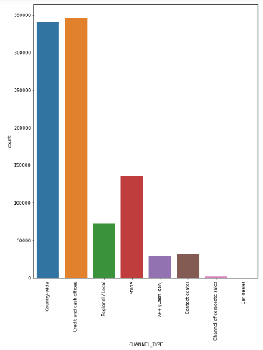
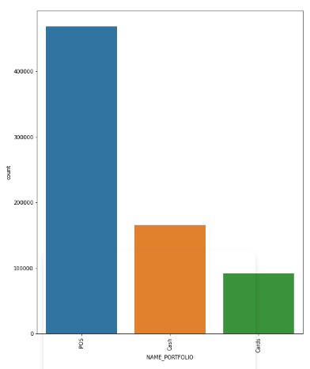
Previous Application Data Analysis
POS loans are highest.
Credit and Cash Offers channel type has highest count. Followed by, Country Wide Channel Type is also has high count.

Slide 7
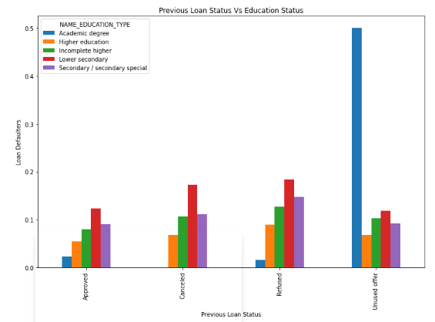
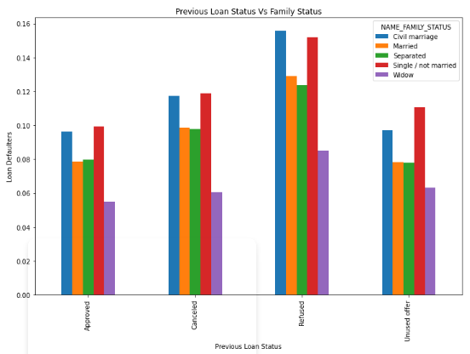
Previous Application Data Analysis
Loan Applicants who Previously refused loans with Lower Secondary Education Status are more likely to default. (Note: Excluded Academic Degree information as it was misleading the analysis.)
Loan Applicants with Civil Marriage as Family Status and Refused previous loan offers are more like to default.

Slide 8
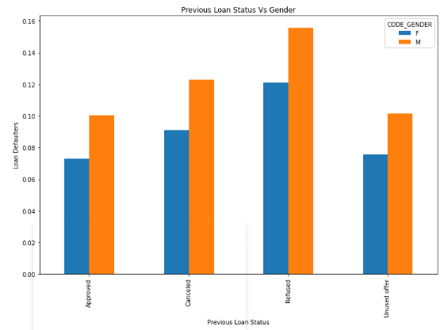
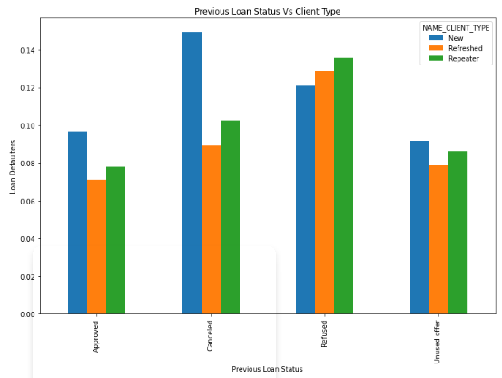
Previous Application Data Analysis
Male Loan Applicants who refused previous loans are more likely to default current application.
New Loan Applicants who previously cancelled loan are more likely to default in current application.

Slide 9
Overall Analysis
Following groups should be preferred to decrease chances of Loan Defaults:-
  High Income groups
  Old Age groups
  Females with Higher Education and Old Age
  Applicants with previously Approved loans
  Refreshed applicants with Approved Loans
  Widow applicant with Approved previous application
  Working loan applicants
  Student, Pensioner, Businessman
Following groups should be avoided to decrease chances of Loan Defaults:-
  Male Applicants with Young Age and Lower secondary education.
  Loan Applicants with Civil Marriage and refused previous loans.
  Loan Applicants who Previously refused loans with Lower Secondary Education Status.
  Male Loan Applicants who refused previous loans
  New Loan Applicants who previously cancelled loans.

